Slide 1



Introduction to Machine Learning
Sébastien De Landtsheer

Slide 2

Outline
Applications of Machine Learning in healthcare
Genomics
Epidemiology
Vision
Others
Data exploration
Distributions
Correlation analysis
The Machine Learning Framework
Data Preprocessing steps
Metrics and Objective Functions
Feature engineering and selection
Validation scheme
Gradient descent
Algorithms
Supervised Regression
Supervised Classification
Ensembling
University of Luxembourg Sébastien De Landtsheer 2

Slide 3
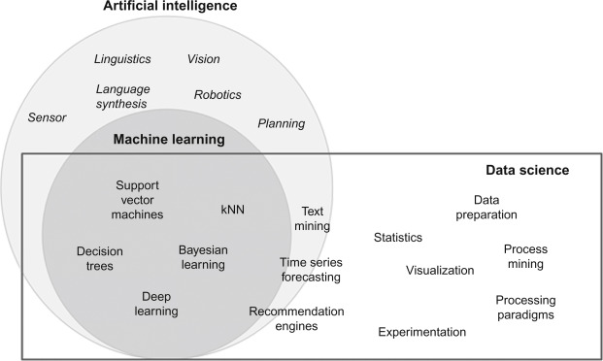
What is machine learning?
Vijay Kotu, Bala Deshpande, in Data Science (Second Edition), 2019
University of Luxembourg Sébastien De Landtsheer 3

Slide 4
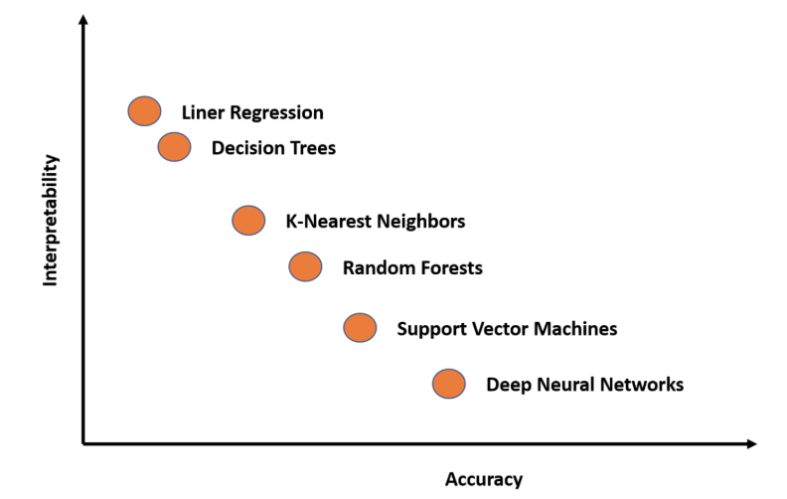
What is machine learning?
human-friendly
interpretable
black boxes
Breiman L, Statistical Modeling: The Two Cultures, Statist. Sci. 16, 3 (2001), 199-231
University of Luxembourg Sébastien De Landtsheer 4

Slide 5
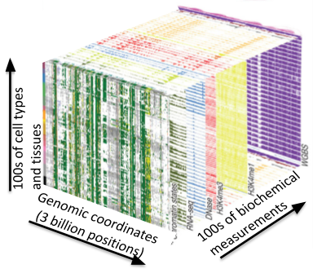
Applications of Machine Learning in healthcare:
genomics
Prediction of sequence specificity of DNA- and RNA-binding proteins
Prediction of enhancer and cis-regulatory regions, methylation status, and splicing sites
Prediction of gene expression from genomic sequences
Prediction of gene-disease associations
Gene annotations for new organisms
Prediction of transcription factor binding sites
Examples:
Kelley, D. R., Snoek, J. & Rinn, J. L. Basset: learning the regulatory code of the accessible genome with deep convolutional neural networks. Genome Res. 26, 990–999 (2016)
Xie, R., Wen, J., Quitadamo, A., Cheng, J. & Shi, X. A deep auto-encoder model for gene expression prediction. BMC Genomics 18 (Suppl. 9), 845 (2017).
University of Luxembourg Sébastien De Landtsheer 5

Slide 6
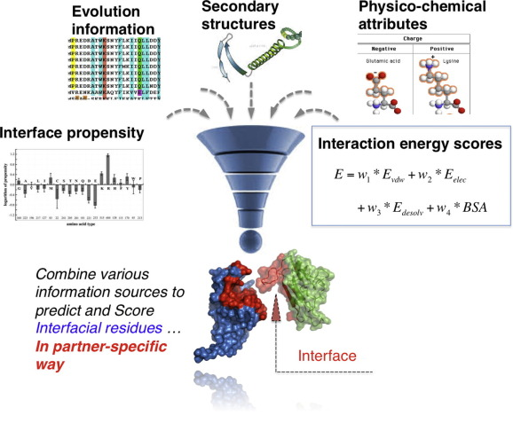
Applications of Machine Learning in healthcare:
protein functions
Prediction of protein function / interactions / surface properties
Sequence-based vs structure-based
Drug design
Examples:
Sureyya Rifaioglu, A., Doğan, T., Jesus Martin, M. et al. DEEPred: Automated Protein Function Prediction with Multi-task Feed-forward Deep Neural Networks. Sci Rep 9, 7344 (2019)
Xue, Li C., Dobbs, Drena, Bonvin, Alexandre M.J.J., et al. Computational prediction of protein interfaces: A review of data driven methods, FEBS Letters 589, 23, 3516-3526
University of Luxembourg Sébastien De Landtsheer 6

Slide 7
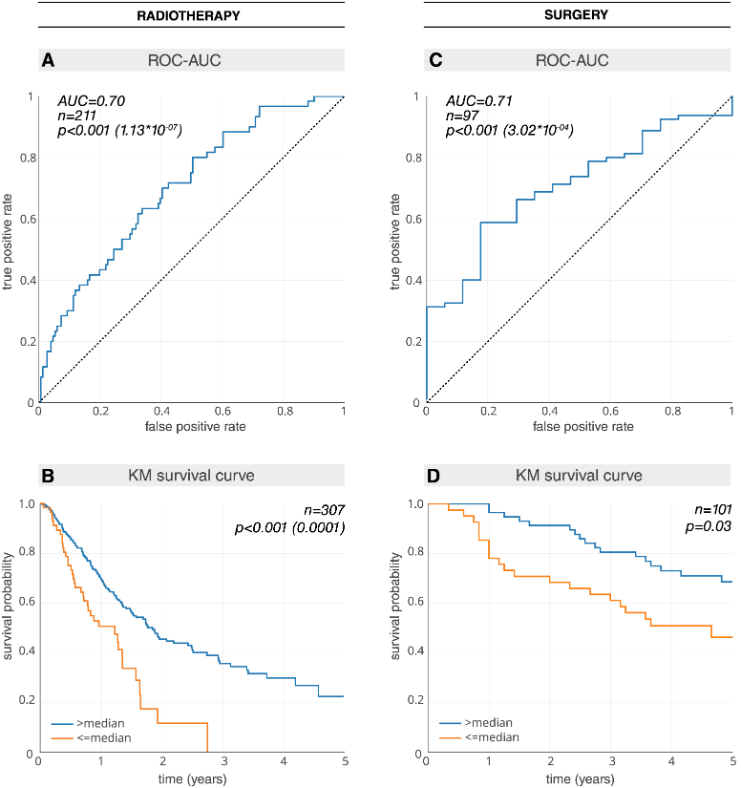
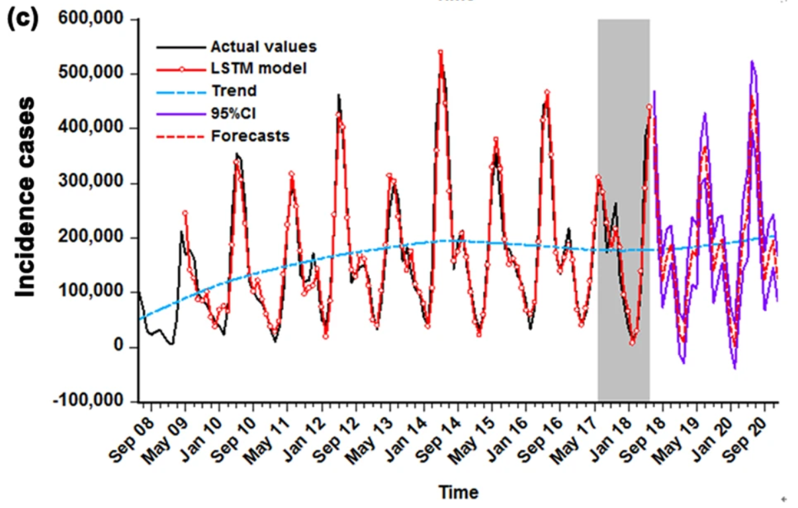
Applications of Machine Learning in healthcare:
epidemiology
Examples:
Hosny A, Parmar C, Coroller TP, Grossmann P, Zeleznik R, et al. (2018) Deep learning for lung cancer prognostication: A retrospective multi-cohort radiomics study. PLOS Medicine 15(11): e1002711
Kim, D.W., Lee, S., Kwon, S. et al. Deep learning-based survival prediction of oral cancer patients. Sci Rep 9, 6994 (2019)
Wang, Y., Xu, C., Zhang, S. et al. Development and evaluation of a deep learning approach for modeling seasonality and trends in hand-foot-mouth disease incidence in mainland China. Sci Rep 9, 8046 (2019)
University of Luxembourg Sébastien De Landtsheer 7

Slide 8
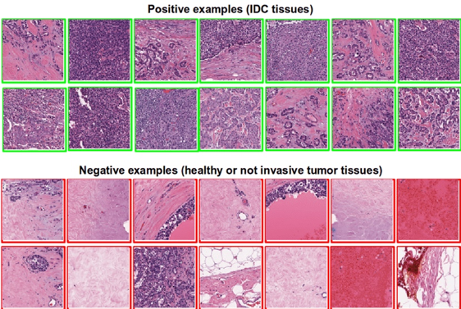
Applications of Machine Learning in healthcare:
computer vision
Coudray, N., Ocampo, P.S., Sakellaropoulos, T. et al. Classification and mutation prediction from non–small cell lung cancer histopathology images using deep learning. Nat Med 24, 1559–1567 (2018)
University of Luxembourg Sébastien De Landtsheer 8

Slide 9
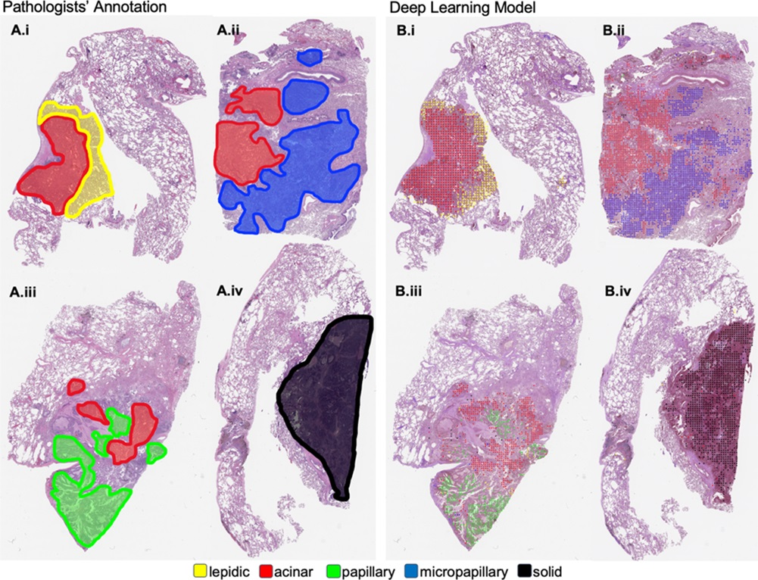
Applications of Machine Learning in healthcare:
computer vision
Wei, J.W., Tafe, L.J., Linnik, Y.A. et al. Pathologist-level classification of histologic patterns on resected lung adenocarcinoma slides with deep neural networks. Sci Rep 9, 3358 (2019)
University of Luxembourg Sébastien De Landtsheer 9

Slide 10
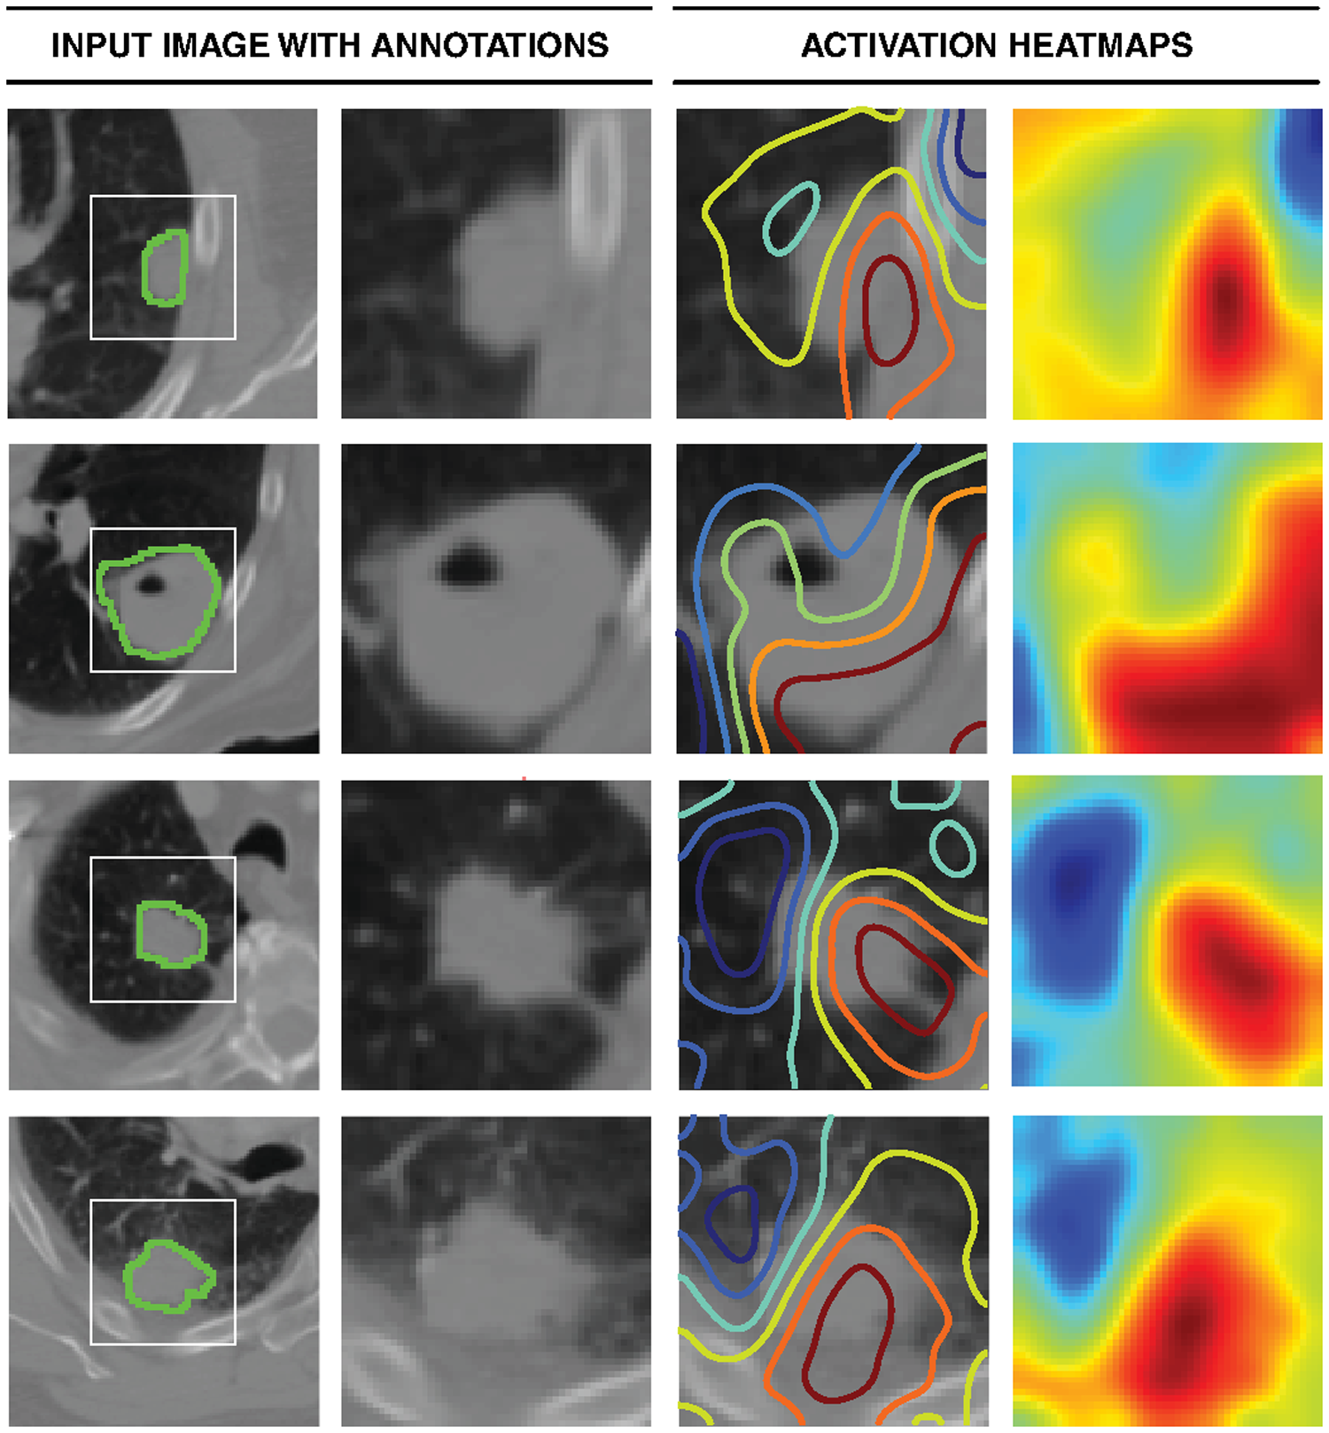
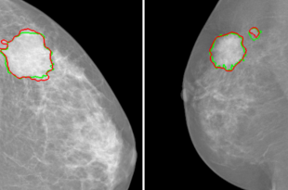
Applications of Machine Learning in healthcare:
computer vision
University of Luxembourg Sébastien De Landtsheer 10

Slide 11
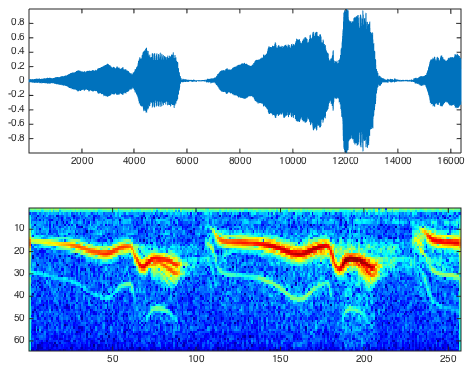
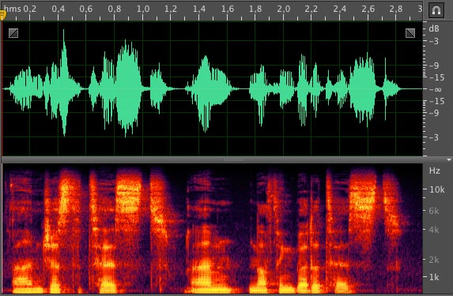
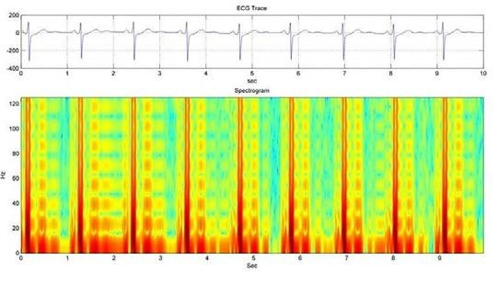
Applications of Machine Learning in healthcare:
computer vision
University of Luxembourg Sébastien De Landtsheer 11

Slide 12
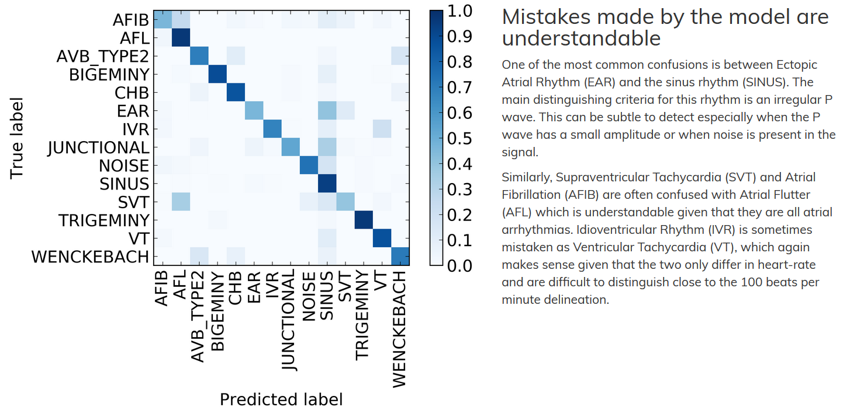
Applications of Machine Learning in healthcare:
Signal analysis
- Hannun, A. Y., Rajpurkar, P., Haghpanahi, M., Tison, G. H., Bourn, C., Turakhia, M. P., & Ng, A. Y. (2019). Cardiologist-level arrhythmia detection and classification in ambulatory electrocardiograms using a deep neural network. Nature medicine, 25(1), 65–69
University of Luxembourg Sébastien De Landtsheer 12

Slide 13
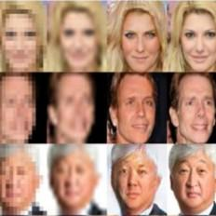
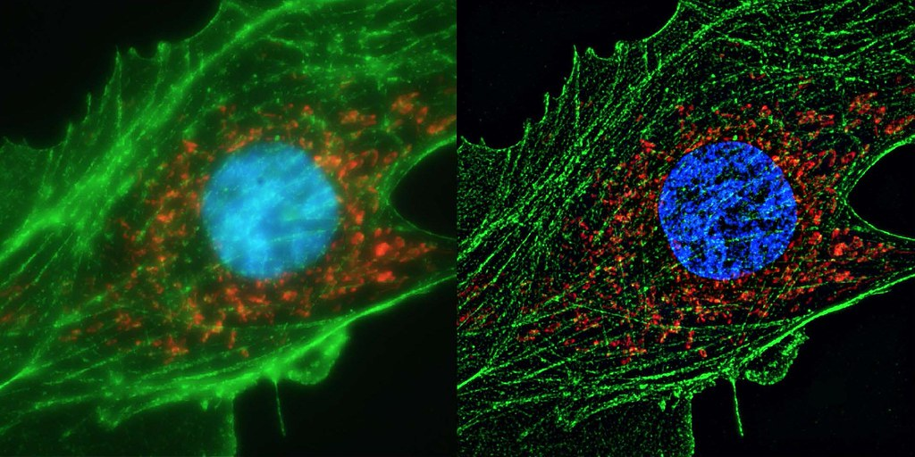
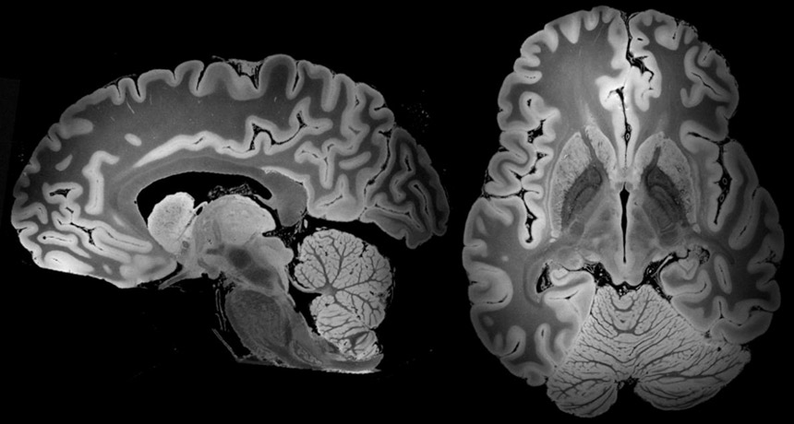
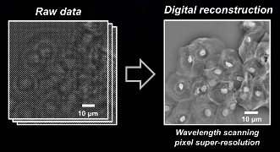
Applications of Machine Learning in healthcare:
Super-resolution
University of Luxembourg Sébastien De Landtsheer 13

Slide 14
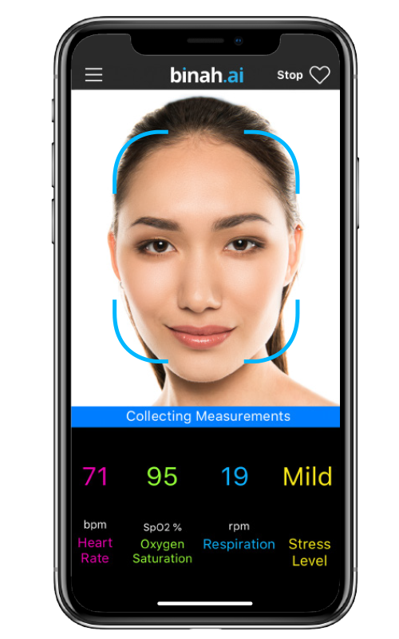
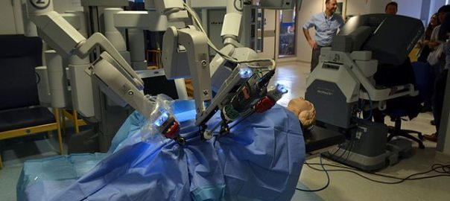
Applications of Machine Learning in healthcare:
other
University of Luxembourg Sébastien De Landtsheer 14

Slide 15
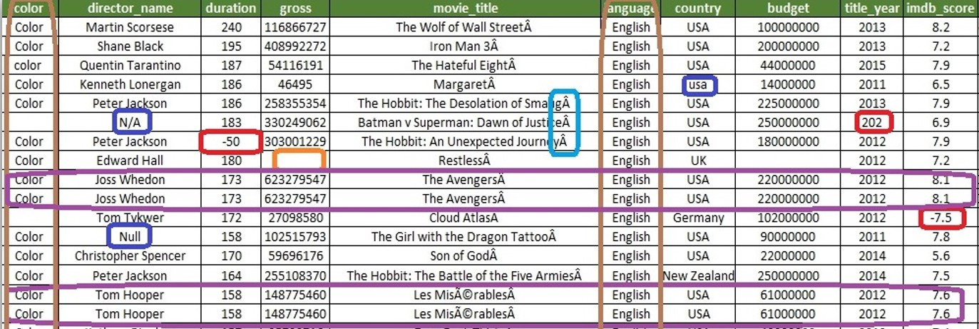
Data exploration
80% of the effort of data modeling is cleaning the data.
Data rarely comes clean. Interesting data is often aggregated, scraped from web, or combined from different sources. Main steps are:
Standardize gene names, use of capitals, units etc
Removing ‘bad’ samples
dates in the future, typos, etc.
too much missing data
Removing ‘bad’ features
pure noise (ID numbers etc.)
invariants
correlated
University of Luxembourg Sébastien De Landtsheer 15

Slide 16
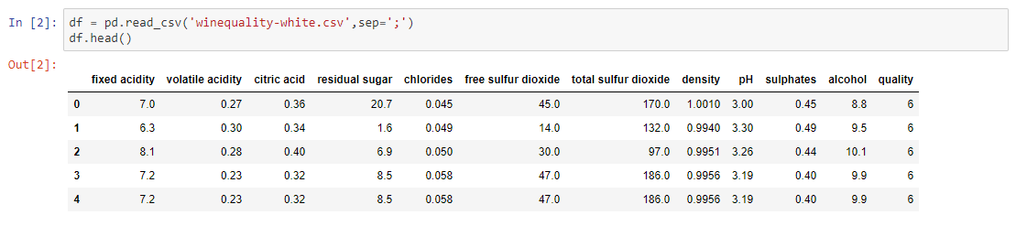
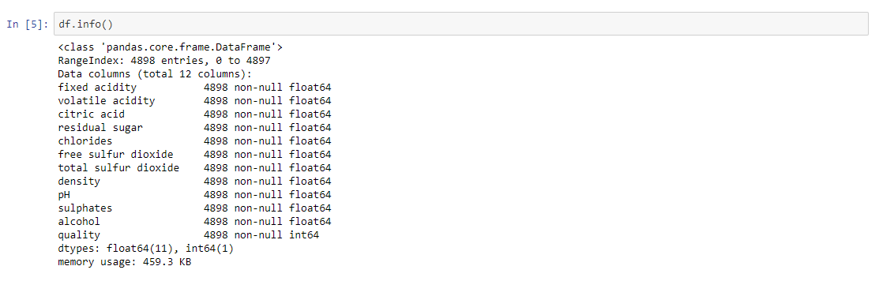
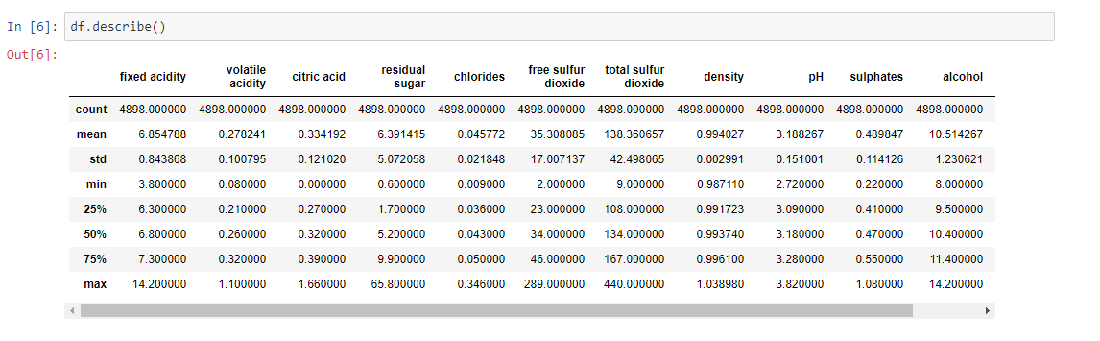
Data exploration
Example: wine quality dataset (https://archive.ics.uci.edu/ml/datasets/wine+quality)
University of Luxembourg Sébastien De Landtsheer 16

Slide 17
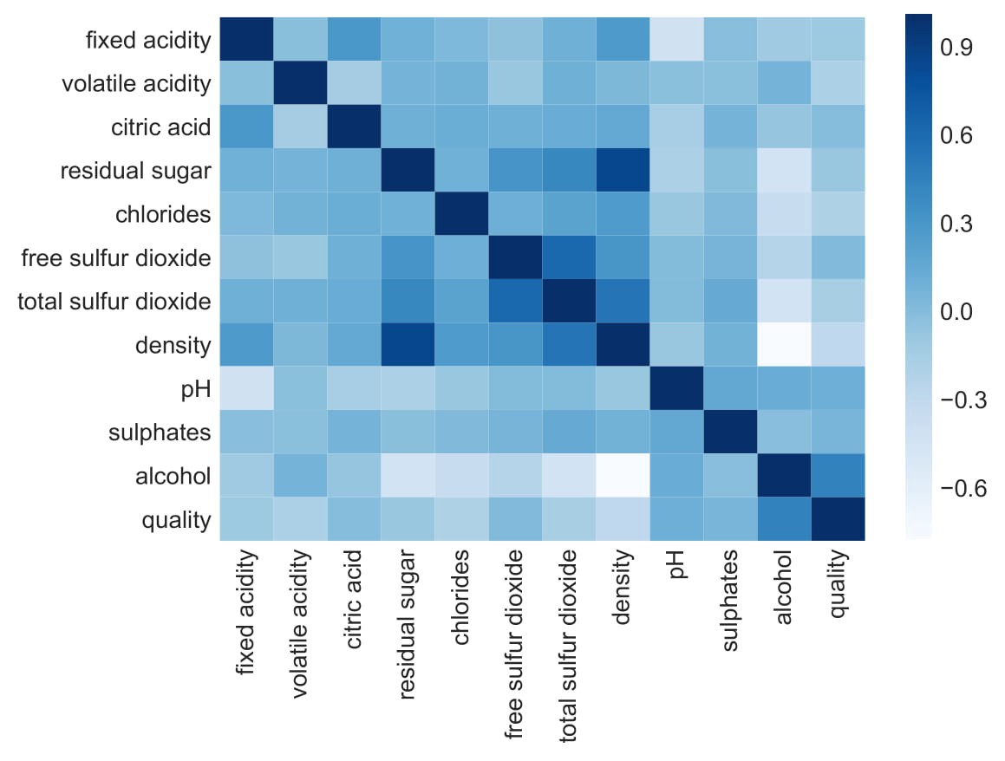
Data exploration
Feature cross-correlation
University of Luxembourg Sébastien De Landtsheer 17

Slide 18
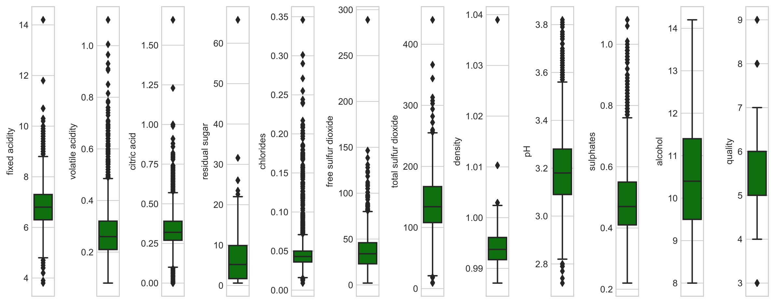
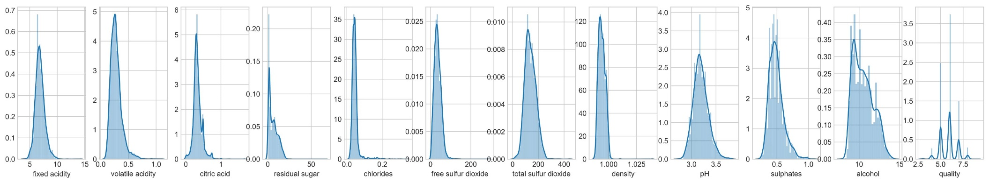
Data exploration
University of Luxembourg Sébastien De Landtsheer 18

Slide 19
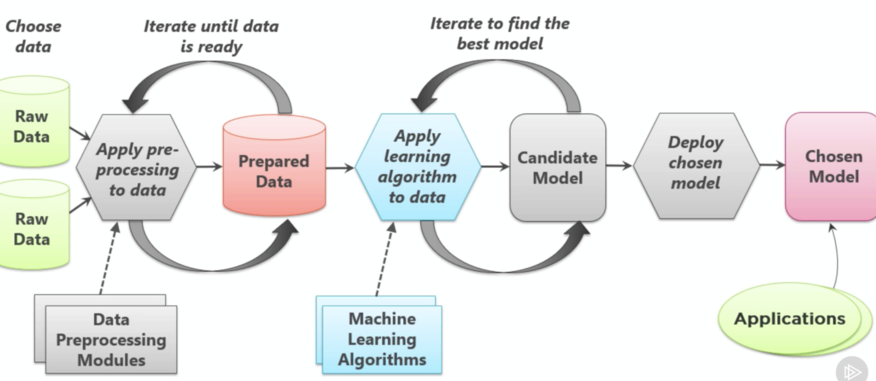
The Machine-Learning framework
University of Luxembourg Sébastien De Landtsheer 19

Slide 20
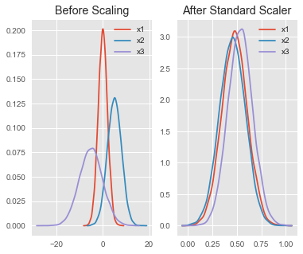
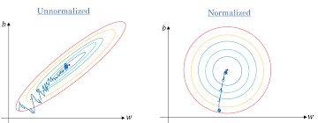
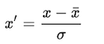
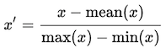
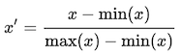
The Machine-Learning framework
Feature scaling: making sure all features are on the same scale
Standardization
Mean normalization
Min-max scaling
University of Luxembourg Sébastien De Landtsheer 20

Slide 21
The Machine-Learning framework
Imputation
Mean imputation:
Fast and easy
Only continuous data
Introduces bias
Median/Most frequent:
Fast and easy
Works on categorical data
Introduces bias
Regression/Interpolation:
Stochastic or not
Dependent of the model assumptions
K-NN imputation:
Computationally intensive
Accounts for feature dependency
Talwar, D., Mongia, A., Sengupta, D. et al. AutoImpute: Autoencoder based imputation of single-cell RNA-seq data. Sci Rep 8, 16329 (2018)
There is no way to recover the missing data. Often the only goal is to make the algorithm work and keeping as much incomplete data as possible
University of Luxembourg Sébastien De Landtsheer 21

Slide 22
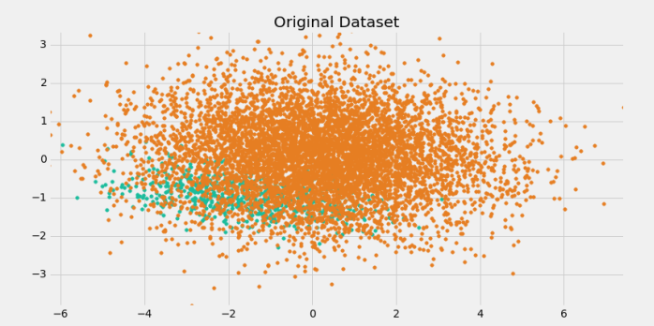
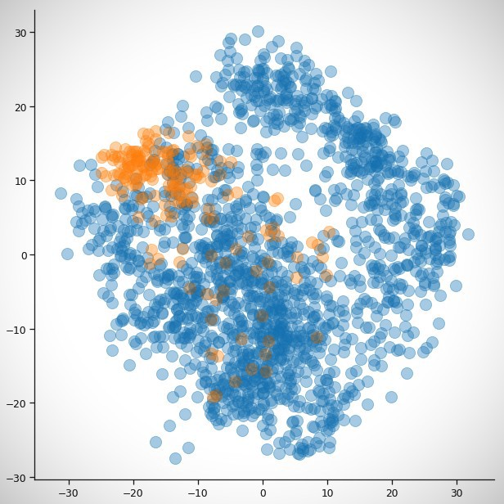
The Machine-Learning framework
Imbalanced datasets are a typical problem in biological sciences
Classifiers have unstable objective functions
Problems in training/test partitions
Review: More, Ajinkya (2016) Survey of resampling techniques for improving classification performance in unbalanced datasets, arXiv:1608.06048
University of Luxembourg Sébastien De Landtsheer 22

Slide 23
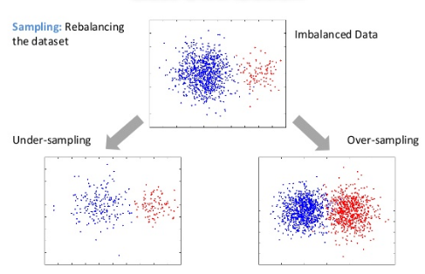

Imbalanced datasets
University of Luxembourg Sébastien De Landtsheer 23

Slide 24
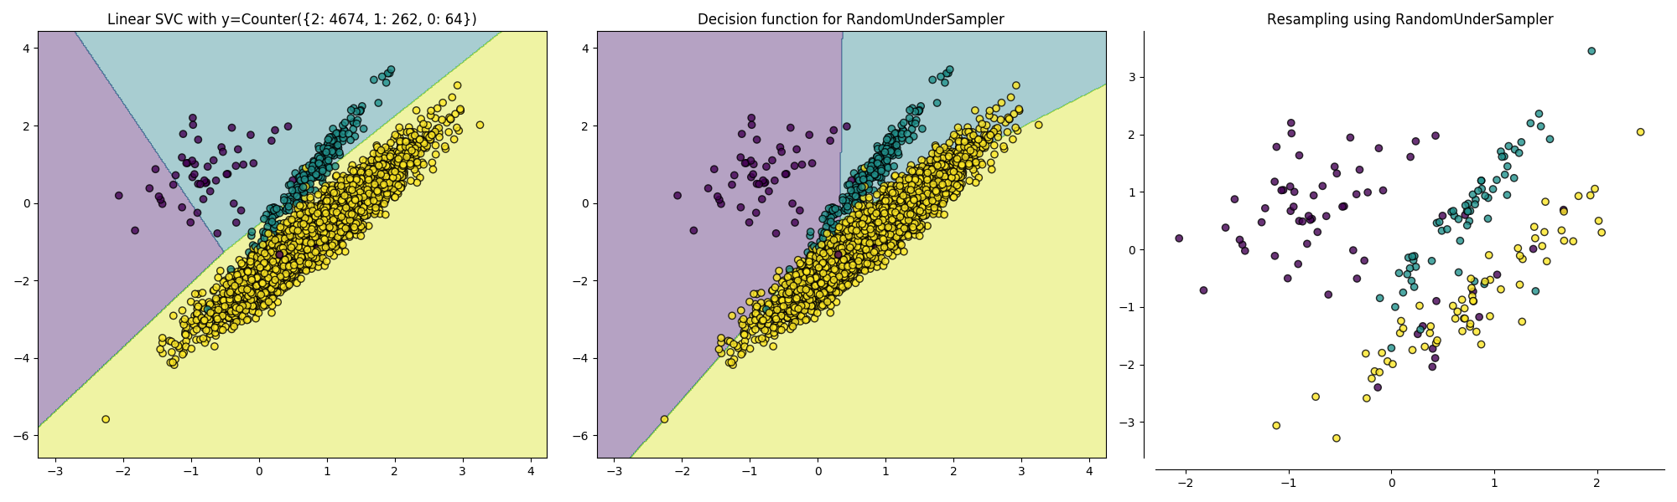
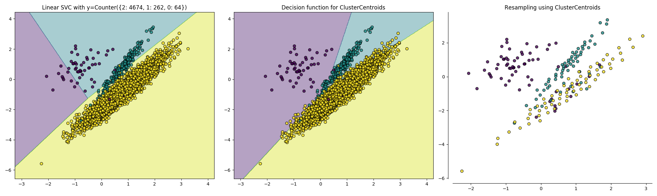
Under/Over-sampling
Random undersampling:
Centroid-based undersampling:
University of Luxembourg Sébastien De Landtsheer 24

Slide 25
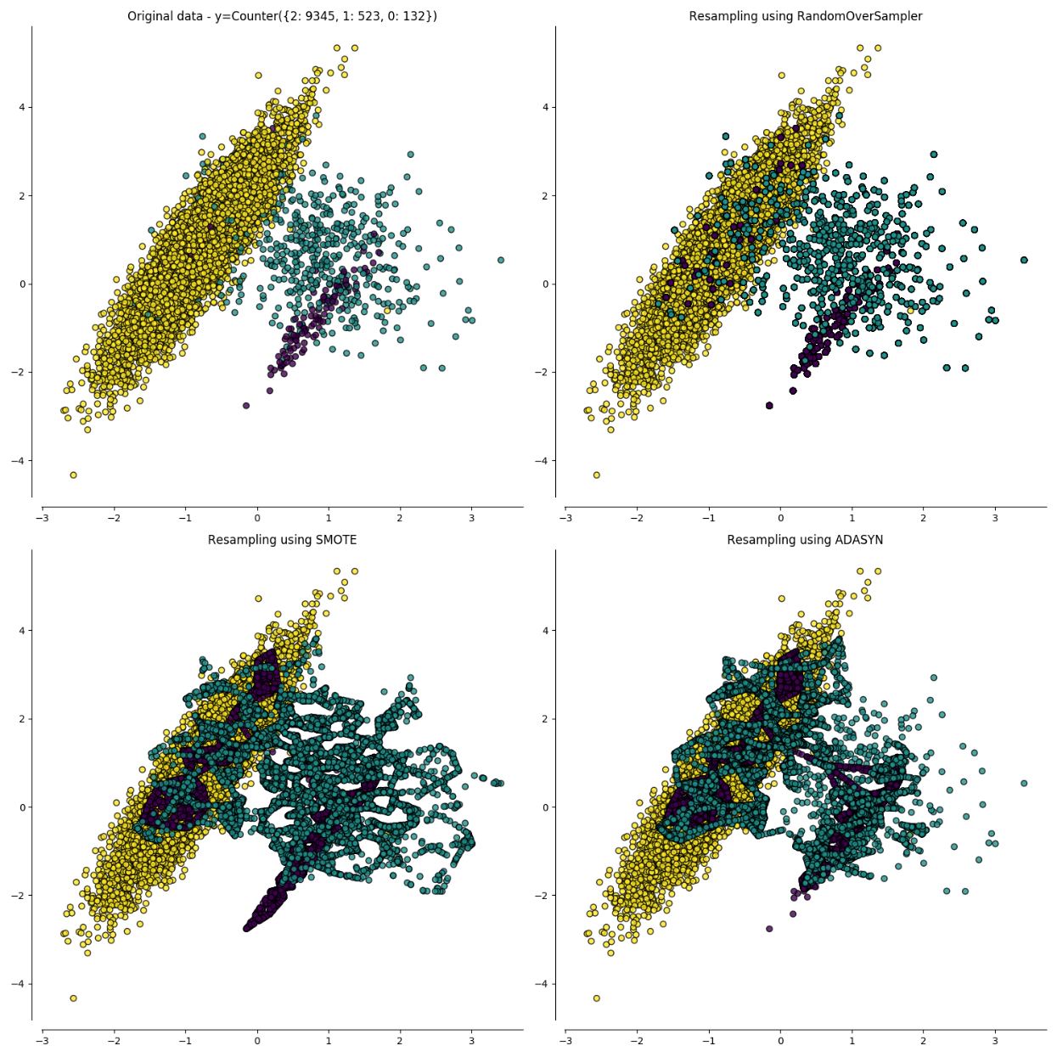
Original
Random
Over-sampling methods try to generate new synthetic samples ‘’in-between’ the actual ones
Datapoints surimpose
SMOTE
AdaSYN
He, Haibo, Yang Bai, Edwardo A. Garcia, and Shutao Li. ADASYN: Adaptive synthetic sampling approach for imbalanced learning, In IEEE International Joint Conference on Neural Networks (IEEE World Congress on Computational Intelligence), pp. 1322-1328, 2008.
N. V. Chawla, K. W. Bowyer, L. O.Hall, W. P. Kegelmeyer, SMOTE: synthetic minority over-sampling technique, Journal of artificial intelligence research, 16, 321-357, 2002.
University of Luxembourg Sébastien De Landtsheer 25

Slide 26
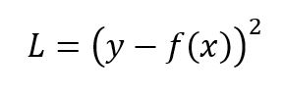
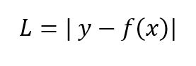
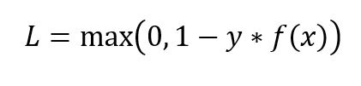
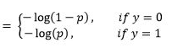
The Machine-Learning framework
Fitting and error functions
For regression:
Sum of squared errors
Sum of absolute errors
For classification:
Log-loss
Hinge loss
(penalizes wrong predictions but also
correct ones that are not confident)
University of Luxembourg Sébastien De Landtsheer 26

Slide 27
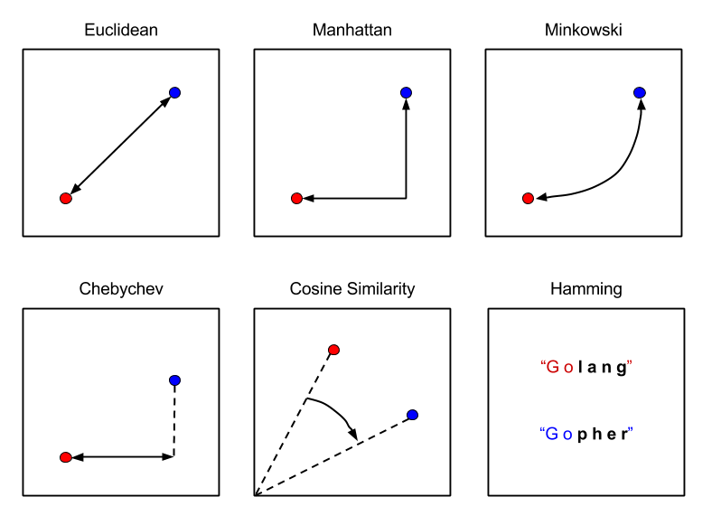
The Machine-Learning framework
Distance metrics (two or more dimensions)
University of Luxembourg Sébastien De Landtsheer 27

Slide 28
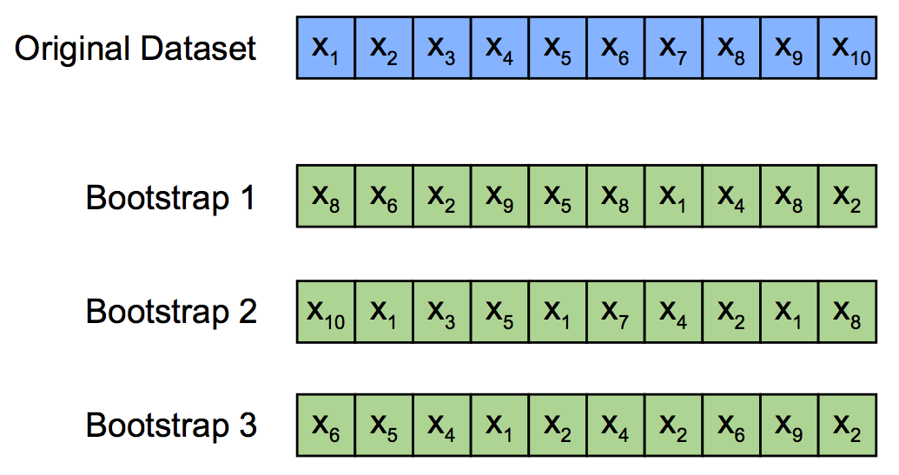
The Machine-Learning framework
Bootstrapping:
Resampling method with replacement to generate a slightly different dataset
Generally used to assess the confidence interval on model parameters estimates
University of Luxembourg Sébastien De Landtsheer 28

Slide 29
What is regularization?
true system
Data = true signal + RANDOM NOISE
Underfit
=
Small model
Large errors
Optimal model
=
More generalizable
Overfit
=
Large model
Small errors
University of Luxembourg Sébastien De Landtsheer 29

Slide 30
Regularization penalizes for model size
Cost function
The more parameters in a model, the smaller the error compared to the training set BUT overfitting
Model size
University of Luxembourg Sébastien De Landtsheer 30

Slide 31
Regularization penalizes for model size
Cost function
The more parameters in a model, the smaller the error compared to the training set BUT overfitting
We can add a function of the parameters (and not of the inputs) to penalize for model complexity
Model size
University of Luxembourg Sébastien De Landtsheer 31

Slide 32
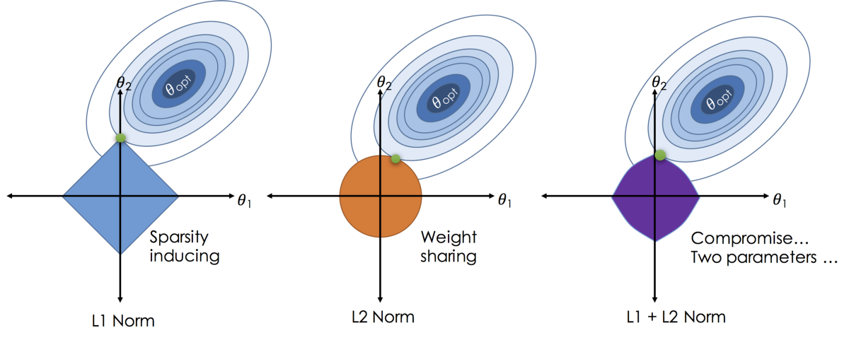
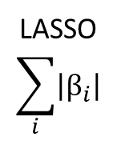
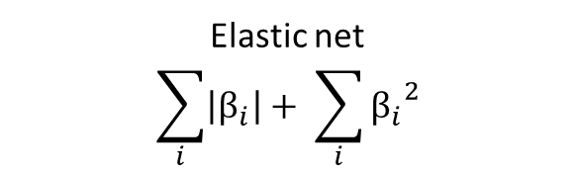
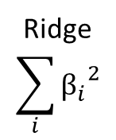
Regularization schemes
LASSO
$$\sum_{i}{\left|β_{i}\right|}$$
Ridge
$$\sum_{i}{{β_{i}}^{2}}$$
Elastic net
$$\sum_{i}{\left|β_{i}\right|}+ \sum_{i}{{β_{i}}^{2}}$$
University of Luxembourg Sébastien De Landtsheer 32

Slide 33
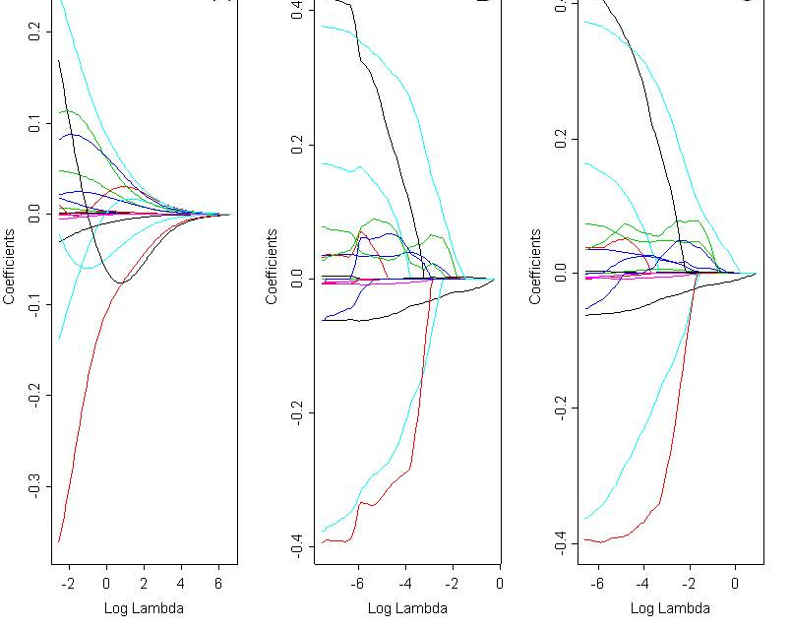
Regularization paths
ridge LASSO elastic net
University of Luxembourg Sébastien De Landtsheer 33

Slide 34
The Machine-Learning framework
Feature engineering (the ‘art’ of machine-learning):
Expert domain knowledge (what the features mean)
Combinations of features (additions, mean, product,…)
Automated generation:
Combinatorial
Deep-learning based
Can lead to feature explosion (too many 1000s of features for the next steps)
J. M. Kanter and K. Veeramachaneni, "Deep feature synthesis: Towards automating data science endeavors," 2015 IEEE International Conference on Data Science and Advanced Analytics (DSAA), Paris, 2015, pp. 1-10.
University of Luxembourg Sébastien De Landtsheer 34

Slide 35
The Machine-Learning framework
Feature selection: selection of the best subset of features among all subsets
Exhaustive search: computationally intensive
Forward selection:
Start with empty model: random choice (classification) or intercept (regression)
Select the most informative feature. Evaluate models (AIC or F-test)
If AIC decreases or F-statistic < α, include in model
Repeat from 2 until no more addition is possible
Backwards elimination:
Start with complete model (all features)
Select the least informative feature. Evaluate models (AIC or F-test)
If AIC decreases or F-statistic > α, remove from model
Repeat from 2 until no more elimination is possible
Combination of forward + backwards
Genetic algorithms / simulated annealing
Wrapper methods (model-dependent subsets)
University of Luxembourg Sébastien De Landtsheer 35

Slide 36

Validations
training
validation
University of Luxembourg Sébastien De Landtsheer 36

Slide 37

Validations
training
validation
University of Luxembourg Sébastien De Landtsheer 37

Slide 38
Validations
training
validation
overfitting
University of Luxembourg Sébastien De Landtsheer 38

Slide 39
Validations
training
test
…
…
…
Train different models
Evaluate model performances:
Biased by the choice of test data
test
University of Luxembourg Sébastien De Landtsheer 39

Slide 40

Cross-validation
training
validation
test
training
validation
training
training
validation
training
training
validation
training
validation
training
Evaluate final models performance
test
Advantage: uses all the data for training
k-fold cross-validation uses k partitions
When$k=n$, ‘leave-one-out’ validation
University of Luxembourg Sébastien De Landtsheer 40

Slide 41





Gradient descent
We have a dataset $X=\left\{x_{i}\right\}n$ , and labels $Y=\left\{y_{i}\right\}n$, as well as learning rate $L$.
We look for the linear regression $y=mx+c$
Let’s start with $m=c=0$,
we have the equation for the squared error:
we can find the derivative w.r.t $m$:
and the derivative w.r.t $c$:
and we can update our estimates of $m$ and $c$.
University of Luxembourg Sébastien De Landtsheer 41

Slide 42
Gradient descent
large negative gradient
=> large step to larger values
large positive gradient
Sum of squared errors
small gradient
=> small step
Initial guess
2nd value
minimum
University of Luxembourg Sébastien De Landtsheer 42

Slide 43

Gradient descent
University of Luxembourg Sébastien De Landtsheer 43

Slide 44


Different types of gradient descent
Batch learning
Learning on the whole training data before updating the parameters
Impractical (RAM size, training time)
Stochastic learning
Updating the parameters after training on a single example
Very fast training but instable
Minibatch learning
Often prefered: combines the advantages of the other two methods
Fancy additions:
Particle swarms
Inertia / velocity
Adaptive learning
Non-differentiable functions:
Subgradients
Interior-point methods
University of Luxembourg Sébastien De Landtsheer 44

Slide 45




Algorithms: supervised regression
Data models: derivation of the linear model
Machine learning: progressive learning
University of Luxembourg Sébastien De Landtsheer 45

Slide 46

Algorithms: supervised regression
Simple linear regression: $y=mx+c$
(only one independent variable)
Multiple linear regression: $y= m_{1}x_{1}+m_{2}x_{2}+m_{3}x_{3}+…+c$
(many independent variables)
Polynomial regression: $y= m_{1}x_{1}+m_{2}{x_{1}}^{2}+m_{3}{x_{1}}^{3}+…+c$
(linear model of non-linear predictors)
Assumptions of linear models:
Linearity
Normality
Independent errors
Non-correlated variables
Homoscedasticity
University of Luxembourg Sébastien De Landtsheer 46

Slide 47


Algorithms: artificial neural networks
multiple inputs
signal integration
threshold response
University of Luxembourg Sébastien De Landtsheer 47

Slide 48


Algorithms: artificial neural networks
University of Luxembourg Sébastien De Landtsheer 48

Slide 49

Algorithms: back-propagation
Gradient descent applied to neural networks (propagate the error backwards)
Chain rule of derivatives: ${\left(f g\right)}^{′}=\left(f^{′}g\right)g′$
X → Y → Z $\frac{dz}{dx}= \frac{dy}{dx} ∙ \frac{dz}{dy}$
Standard logistic activation function: $f\left(x\right)= \frac{1}{1+e^{−x}}$
Derivative: $f^{′}\left(x\right)=−{\left(1+e^{−x}\right)}^{−2}\left(−e^{−x}\right)$
$f^{′}\left(x\right)= \frac{e^{−x}}{{(1+e^{−x})}^{2}}$
which is $f^{′}\left(x\right)=f(x)(1−f(x))$
Rumelhart, D., Hinton, G. & Williams, R. Learning representations by back-propagating errors. Nature 323, 533–536 (1986)
University of Luxembourg Sébastien De Landtsheer 49

Slide 50
Algorithms: back-propagation
Example:
b1
b2
o1
i1
w₁
h1
w₅
w₂
w₆
w₃
w₇
o2
i2
h2
w₈
w₄
University of Luxembourg Sébastien De Landtsheer 50

Slide 51
Algorithms: back-propagation
Example:
For {i₁, i₂} = {0.05, 0.1} we want {o₁, o₂} = {0.01, 0.99}
0.35
0.6
o1
i1
0.15
h1
0.4
0.25
0.5
o2
i2
0.2
h2
0.45
0.3
0.55
input value
weight
net
(sum)
sigmoid
out
University of Luxembourg Sébastien De Landtsheer 51

Slide 52


Algorithms: back-propagation
Example:
For {i₁, i₂} = {0.05, 0.1} we want {o₁, o₂} = {0.01, 0.99}
net_{h1} = $w_{1}i_{1}+w_{3}i_{2}+b_{1}$ = 0.15 * 0.05 + 0.2*0.1 + 0.35*1 = 0.3775
out_{h1} = $\frac{1}{1+e^{{−net}_{h1}}}$ = 0.5932
net_{h2} = $w_{2}i_{1}+w_{4}i_{2}+b_{1}$ = 0.25 * 0.05 + 0.3*0.1 + 0.35*1 = 0.3925
out_{h2} = $\frac{1}{1+e^{{−net}_{h2}}}$ = 0.5968
0.35
0.6
o1
i1
0.15
h1
0.4
0.25
0.5
o2
i2
0.2
h2
0.45
0.3
0.55
University of Luxembourg Sébastien De Landtsheer 52

Slide 53

Algorithms: back-propagation
For {i₁, i₂} = {0.05, 0.1} we want {o₁, o₂} = {0.01, 0.99}
net_{o1} = $w_{5}h_{1}+w_{7}h_{2}+b_{2}$ = 0.4 * 0.5932 + 0.45 * 0.5968 + 0.6 = 1.1059
out_{o1} = $\frac{1}{1+e^{{−net}_{o1}}}$ = 0.7513
net_{o2} = $w_{6}h_{1}+w_{8}h_{2}+b_{2}$ = 0.5 * 0.5932 + 0.55 * 0.5968 + 0.6 = 1.5531
out_{o2} = $\frac{1}{1+e^{{−net}_{h2}}}$ = 0.7729
0.35
0.6
o1
i1
0.15
h1
0.4
0.25
0.5
o2
i2
0.2
h2
0.45
0.3
0.55
University of Luxembourg Sébastien De Landtsheer 53

Slide 54

Algorithms: back-propagation
Repeat until the last layer:
For {i₁, i₂} = {0.05, 0.1} we want {o₁, o₂} = {0.01, 0.99}
out_{o1} = $\frac{1}{1+e^{{−net}_{o1}}}$ = 0.7513 but target_{o1} is 0.01
out_{o2} = $\frac{1}{1+e^{{−net}_{h2}}}$ = 0.7729 but target_{o2} is 0.99
Therefore $E_{o_{1}}= 1/2\left(\text{target}\text{o}\text{1}−\text{out}\text{o}\text{1}\right)2$ = 0.5 (0.01-0.7513)² = 0.2748
and $E_{o_{2}}= 1/2\left(\text{target}\text{o}2−\text{out}\text{o}2\right)2$ = 0.5 (0.99-0.7729)² = 0.0235
$Etotal=$0.2983
0.35
0.6
o1
i1
0.15
h1
0.4
0.25
0.5
o2
i2
0.2
h2
0.45
0.3
0.55
University of Luxembourg Sébastien De Landtsheer 54

Slide 55

Algorithms: back-propagation
Let’s update w₅:
g$radient of error : \frac{∂E_{total}}{∂w_{5}}= \frac{∂E_{total}}{∂{out}_{o1}}$ (output minus target) = 0.7513 – 0.01 = 0.7413
$∗ \frac{∂{out}_{o1}}{∂{net}_{o1}} (logistic derivative)$ = 0.7513 (1-0.7513) = 0.1868
$∗ \frac{∂{net}_{o1}}{∂w_{5}}$ (weight dependence) = 0.5932
0.35
0.6
o1
i1
0.15
h1
w₅
0.25
0.5
o2
i2
0.2
h2
0.45
0.3
0.55
University of Luxembourg Sébastien De Landtsheer 55

Slide 56

Algorithms: back-propagation
Finally: $\frac{∂E_{total}}{∂w_{5}}=\frac{∂E_{total}}{∂{out}_{o1}}∗\frac{∂{out}_{o1}}{∂{net}_{o1}} ∗ \frac{∂{net}_{o1}}{∂w_{5}}$
= 0.7413 * 0.1868 * 0.5932 = 0.0821
Update the value of w₅: 0.4 – η * 0.0821 = 0.3589
And similarly for the other weights: w₆: 0.4086
w₇: 0.5113
w₈: 0.5613
Repeat the process for the hidden layer
One training epoch completed (stochastic learning) with learning rate 0.5
0.35
0.6
o1
i1
0.15
h1
0.3589
0.25
0.5113
o2
i2
0.2
h2
0.4086
0.3
0.5613
University of Luxembourg Sébastien De Landtsheer 56

Slide 57



Algorithms: deep learning
Fully-connected networks => explosion of parameters
convolutions pooling
University of Luxembourg Sébastien De Landtsheer 57

Slide 58

Algorithms: deep learning
University of Luxembourg Sébastien De Landtsheer 58

Slide 59

Algorithms: deep learning
Alex Krizhevsky, Ilya Sutskever, Geoffrey E. Hinton, ImageNet Classification with Deep Convolutional Neural Networks, Advances in Neural Information Processing Systems 25 (NIPS 2012)
University of Luxembourg Sébastien De Landtsheer 59

Slide 60



Algorithms: deep learning
The larger the network, the more data is needed to train the model, but the results are worth it
University of Luxembourg Sébastien De Landtsheer 60

Slide 61
Algorithms: k-nearest neighbors
Pros: Cons:
Non-parametric / easy to understand Need the whole training data in memory
Used for classification and regression Sensitive to scale problems
No assumption about the data
x2
x1
University of Luxembourg Sébastien De Landtsheer 61

Slide 62
Algorithms: k-nearest neighbors
1-nearest: only
3-nearest: majority
x2
x1
University of Luxembourg Sébastien De Landtsheer 62

Slide 63

Algorithms: logistic classification
Main algorithm for basic classification
We replace the linear assumption:
by the logistic assumption:
and define a new cost function
University of Luxembourg Sébastien De Landtsheer 63

Slide 64

Algorithms: logistic classification
Fast and easy to compute
Works well for smooth decision boundaries
Does not work for highly non-linear dependencies
Low variance (hard to overfit)
University of Luxembourg Sébastien De Landtsheer 64

Slide 65

Algorithms: decision trees
Classification and Regression Trees (CART)
Pros: Cons:
Insensitive to scaling High bias / high variance (single)
Insensitive to missing data Prone to overfit
Human-readable
University of Luxembourg Sébastien De Landtsheer 65

Slide 66
Algorithms: decision trees
Classification and Regression Trees (CART) are built in a step-wise way:
Choose the feature which best splits the data -> first node
On each branch find the best split -> subsequent nodes
Stopping criteria: leave cardinality or depth
what is best?
Gini impurity (probability of misclassification)
information gain
variance reduction
University of Luxembourg Sébastien De Landtsheer 66

Slide 67

Algorithms: Random forests
University of Luxembourg Sébastien De Landtsheer 67

Slide 68

Algorithms: Random forests
University of Luxembourg Sébastien De Landtsheer 68

Slide 69

Algorithms: Boosting
AdaBoost (adaptive boosting):
Build a simple classifier (decision stump) on the original dataset
Increase the weight of misclassified samples
Build a second classifier with weighted objective function, add to ensemble
…
Stopping criteria: number of learners, improvement
University of Luxembourg Sébastien De Landtsheer 69

Slide 70



Algorithms: Boosting
Gradient Boosting Machine:
Build a simple classifier (decision stump) on the original dataset
Build a second classifier on the residuals of the first prediction, add to ensemble
…
Stopping criteria: number of learners, improvement
University of Luxembourg Sébastien De Landtsheer 70

Slide 71

Algorithms: stacking
Meta-learning with different classifiers
Different models make different types of errors
One meta-model is using the other models predictions as features
knn-3 gbm logistic … … XGBoost
University of Luxembourg Sébastien De Landtsheer 71

Slide 72
Recommended resources
Books:
The Elements of Statistical Learning, Trevor, Hastie and Tibshirani
Pattern Recognition and Machine Learning, Bishop
Artificial Intelligence for Humans, vol1, 2, 3, Heaton
Courses:
Andrew Ng’s Machine Learning course on Coursera (somewhat practical)
Udemy (for python and R)
fast.ai (very applied)
Bad sources:
Siraj Raval’s videos
Random blog posts with clickbaity titles
Playground:
http://playground.tensorflow.org
Total beginner: www.towardsdatascience.com
Test your skills and earn money: Kaggle competitions
University of Luxembourg Sébastien De Landtsheer 72

Slide 73
Thank you for your attention !
University of Luxembourg Sébastien De Landtsheer 73
University of Luxembourg Sébastien De Landtsheer 73

